Slide 1

Visualizing Multidimensional Health Status of Data Centers
Presenter
Dr. Tommy Dang
Assistant Professor, Texas Tech University
Faculty
Dr. Yong Chen
Associate Professor, Texas Tech University
Dr. Allen Sill
HPCC Managing Director, Texas Tech University
Industry
Jon Hass
Software Architect at Dell Inc.

Slide 2
Outline
Introduction
Background and related work
Visualization architecture: Why Multidimensional analysis?
Demo
Future work

Slide 3
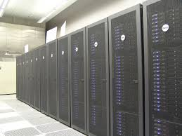



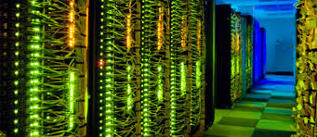
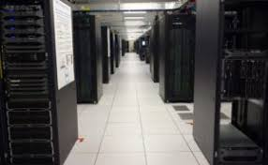
Introduction
HPCC – Texas Tech University
Hewlett Packard Enterprise
IBM.com
Intel.com
HPC - Southern California
Dell EMC

Slide 4
Project Overview
Monitoring data centers is challenging due to their size, complexity, and dynamic nature.
This project proposes visual approaches for situational awareness and health monitoring of HPC systems.
The visualization is expanded on the following dimensions:
HPC spatial layout
Temporal domain (historical vs. real-time tracking)
System health services such as temperature, memory usage, fan speed, and power consumption.

Slide 5
Project Overview
We therefore focus the following design goals:
Provides spatial and temporal overview across hosts and racks,
Inspects the correlation of system health services such as temperature vs. fan speed.
Deliverables
Multidimensional prototypes for visualizing health status of HPC centers within a single view
An intelligent interface that allows viewers to quickly narrow down features or event of interest

Slide 6
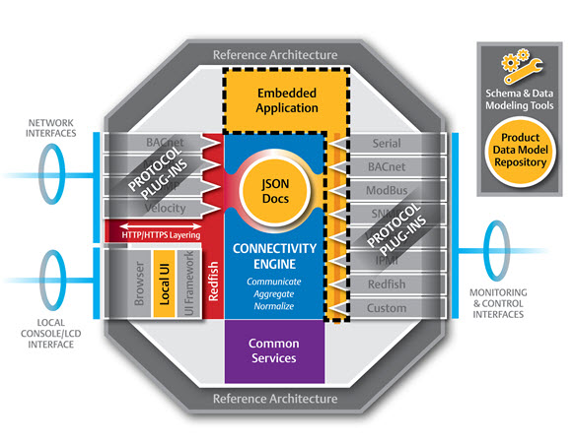

Background
DMTF released Redfish. Nagios Core is integrated with Redfish API to fetch system status.
Notes:
a priori approach – instead of establishing a research question prior to performing an experiment, we let the data tell us which variables are important

Slide 7
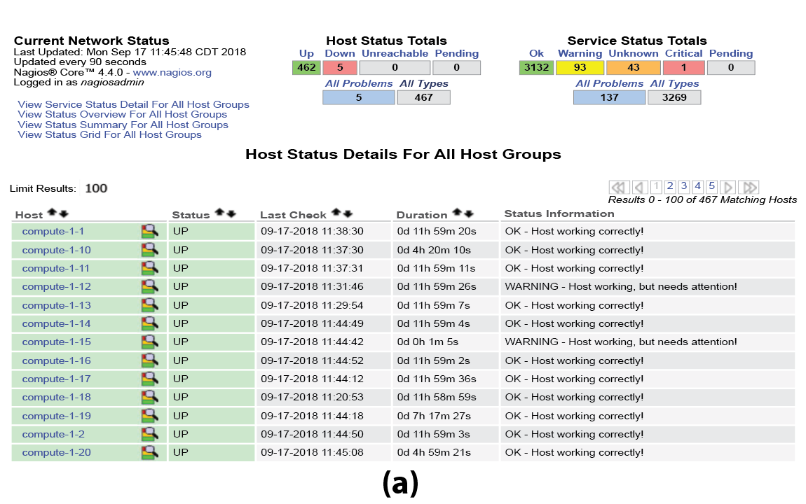
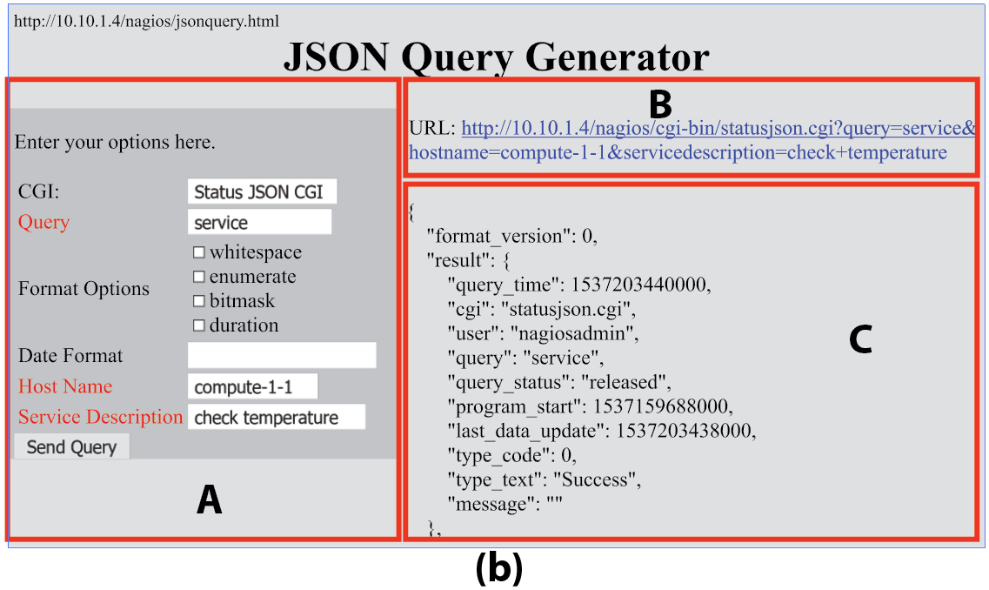
Background and Related Research
Notes:
a priori approach – instead of establishing a research question prior to performing an experiment, we let the data tell us which variables are important

Slide 8
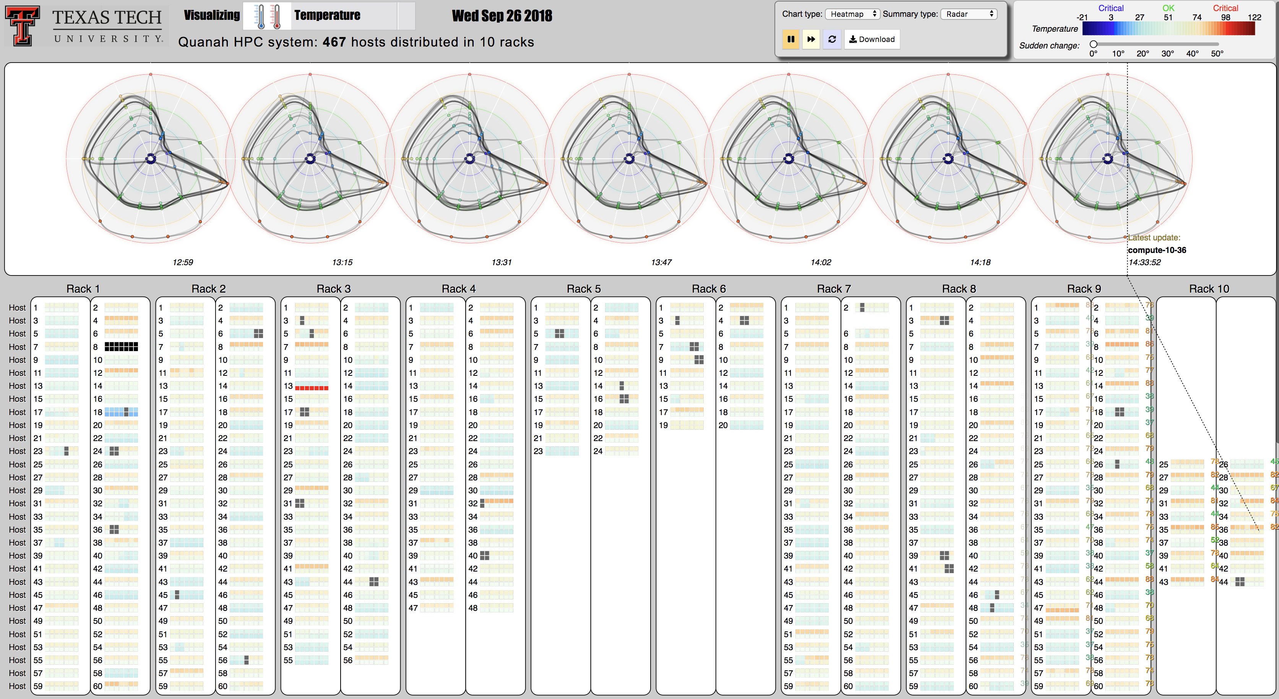
Background
Notes:
a priori approach – instead of establishing a research question prior to performing an experiment, we let the data tell us which variables are important

Slide 9
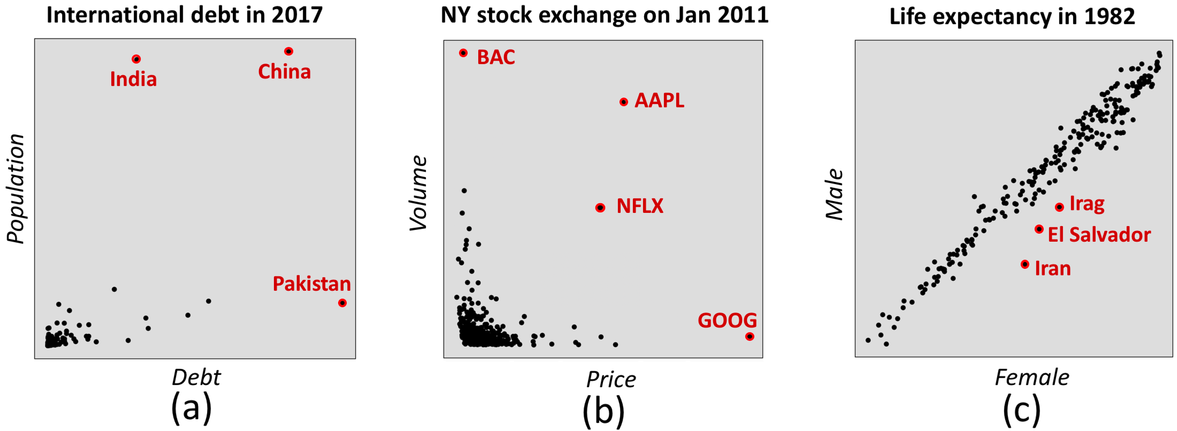
Multi-dimensional analytics
Why?

Slide 10
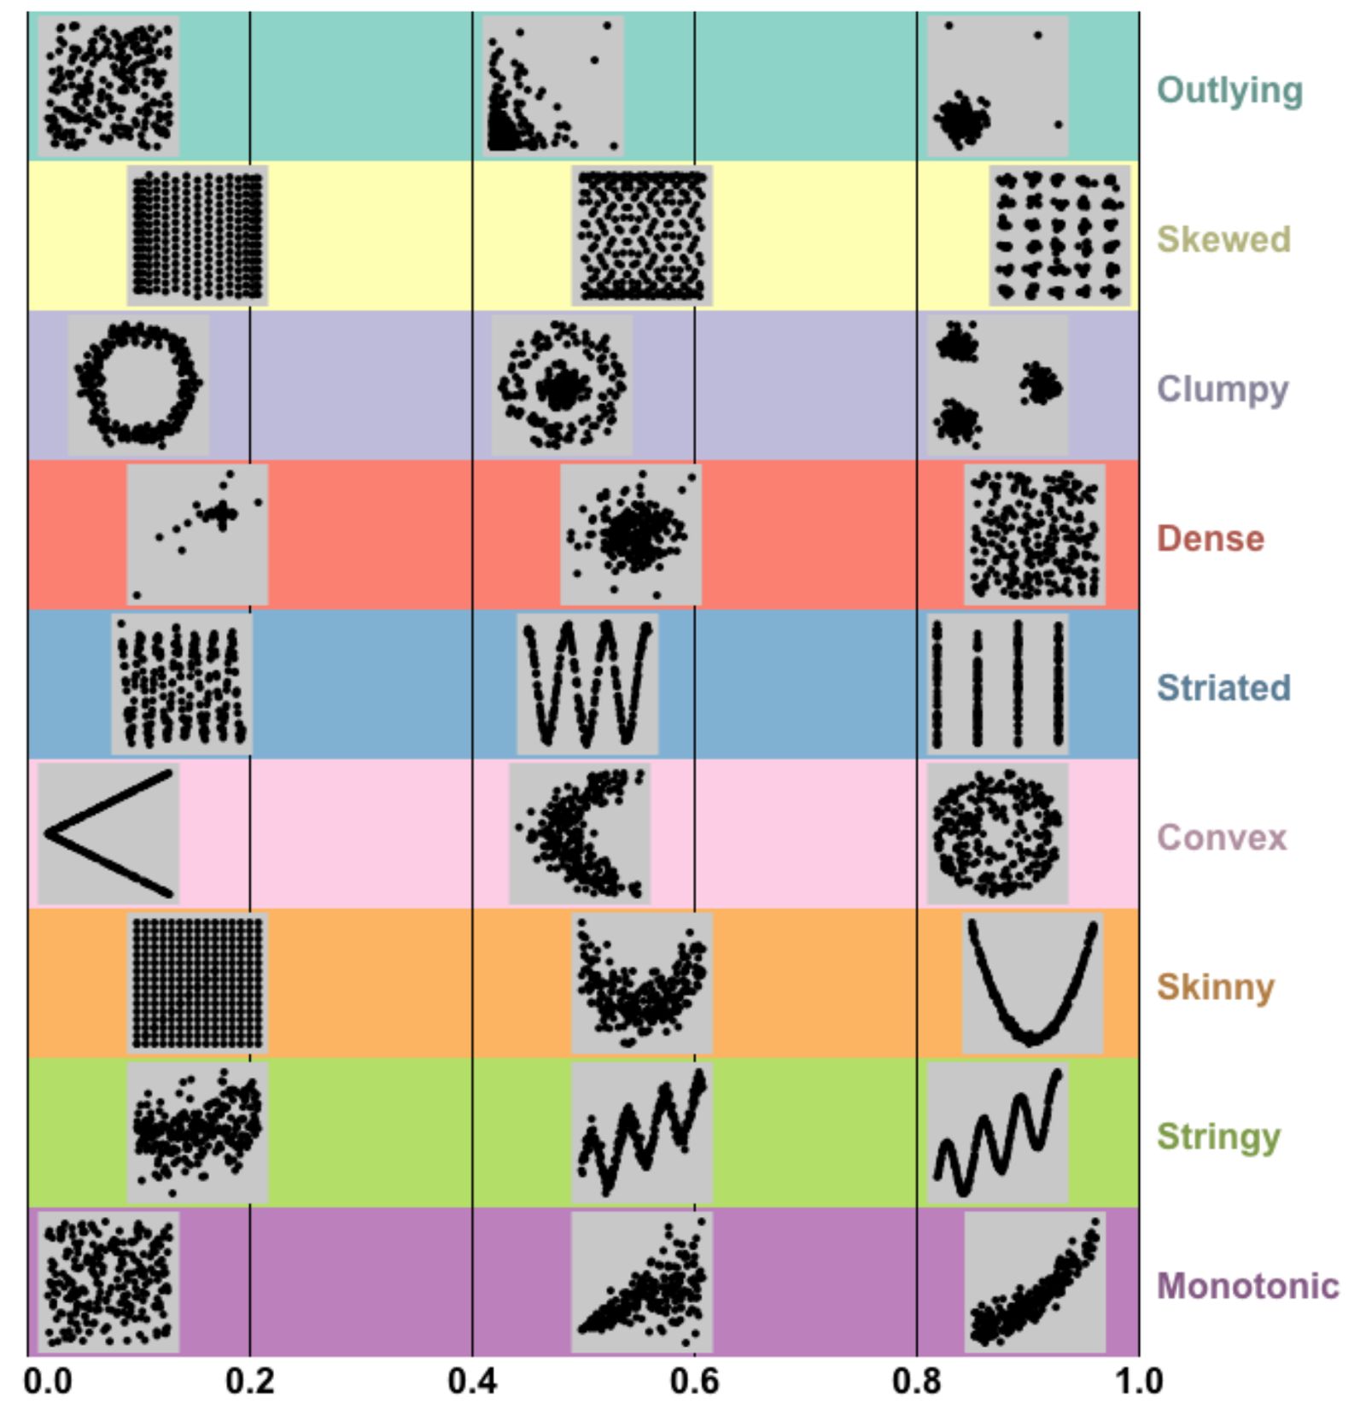
Multi-dimensional analytics

Slide 11
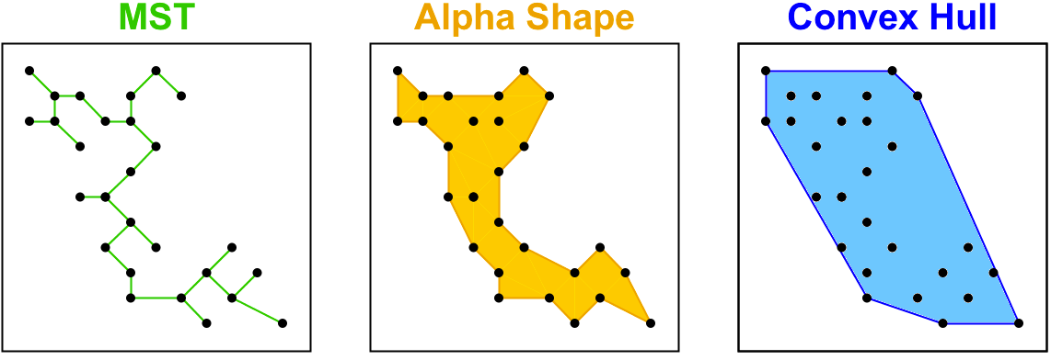
Multi-dimensional analytics

Slide 12
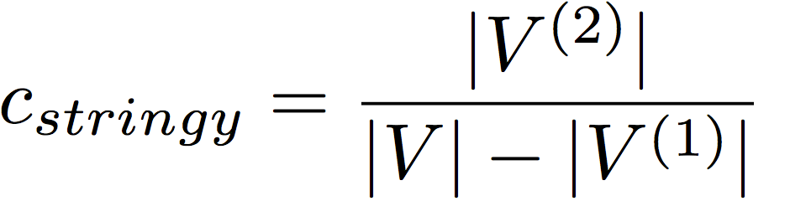
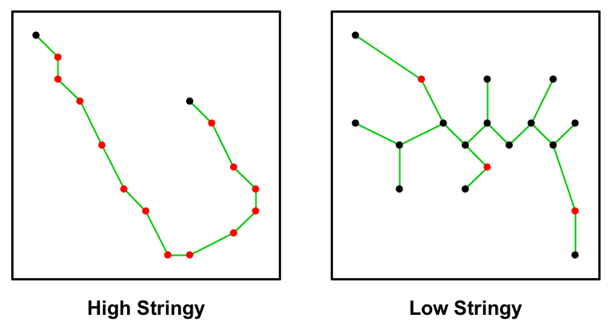
Multi-dimensional analytics

Slide 13
An initial interface has been developed

Slide 14
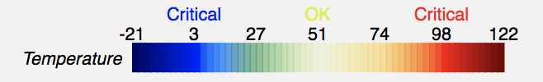
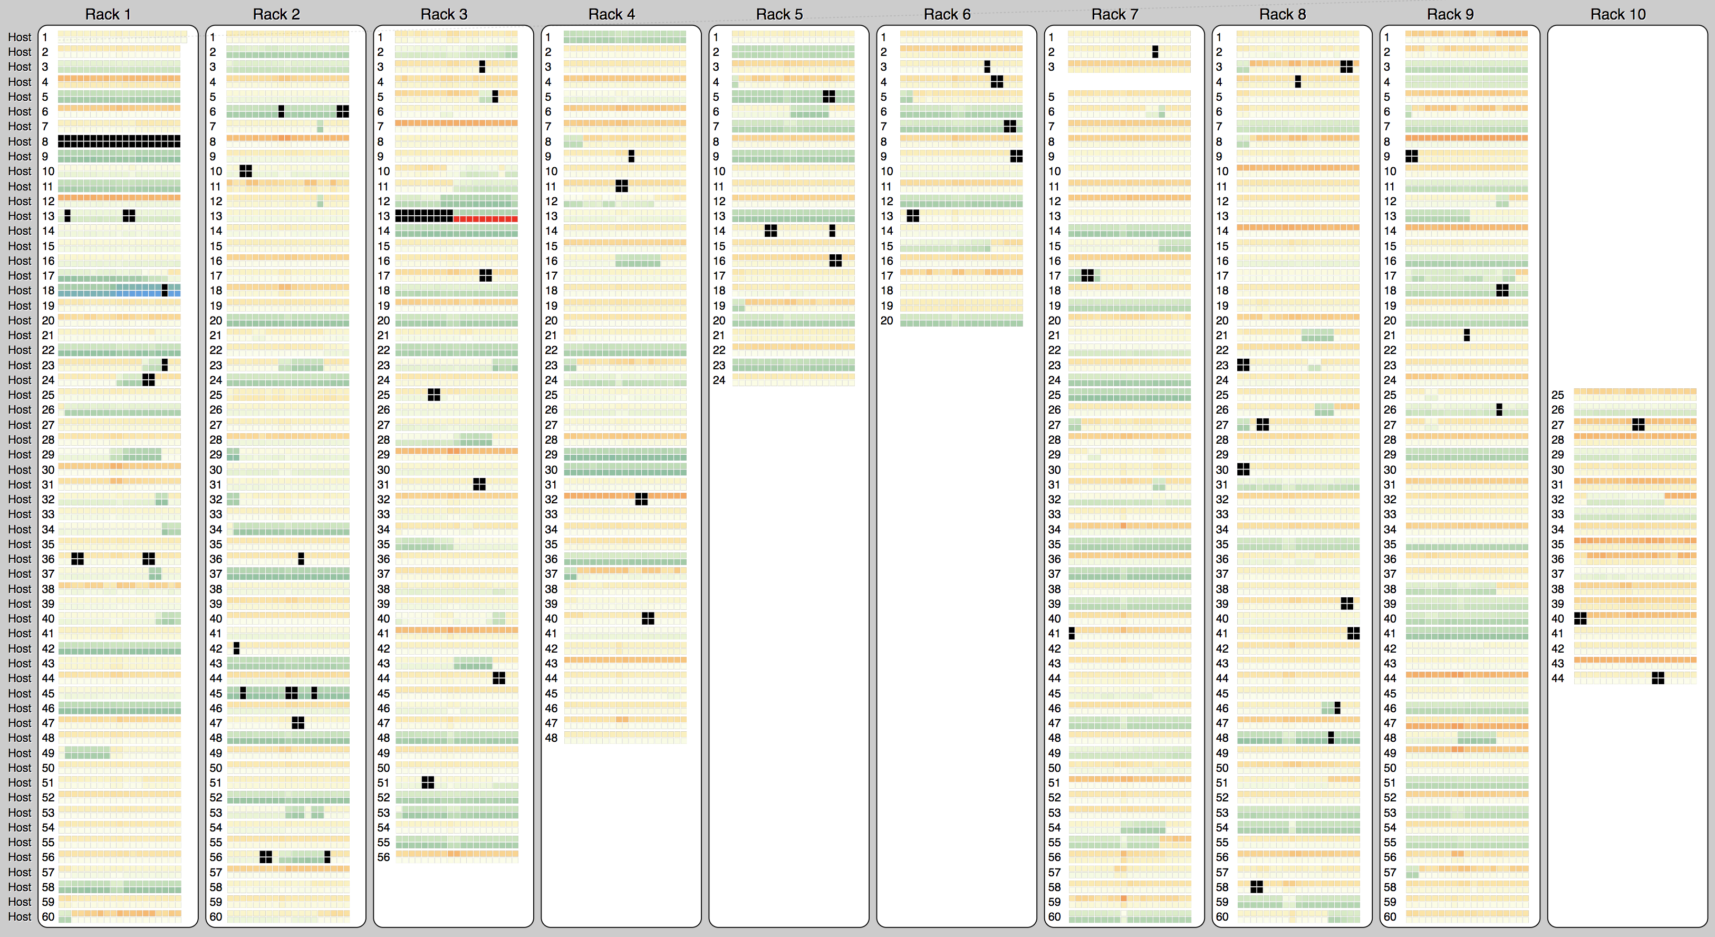
HPCC on Sep, 26 2018: CPU temperature

Slide 15
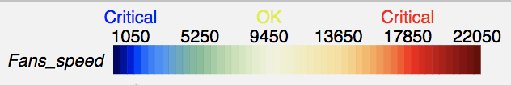
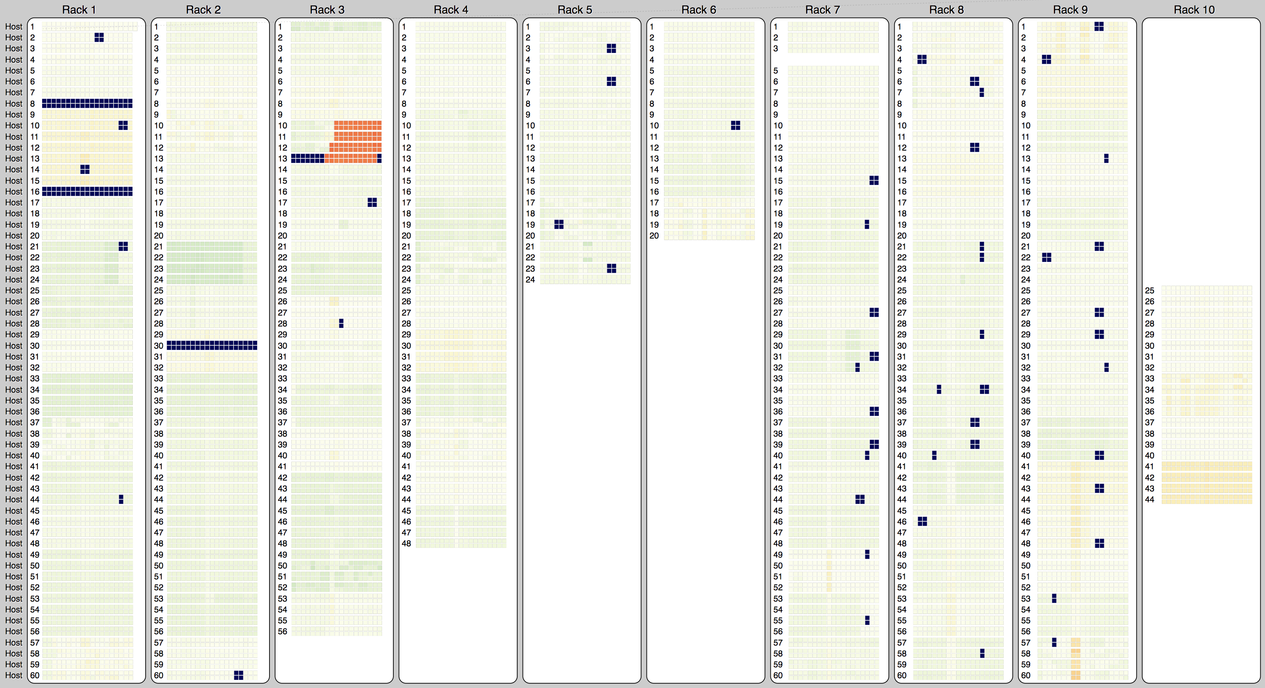
HPCC on Sep, 26 2018: Fan speed

Slide 16
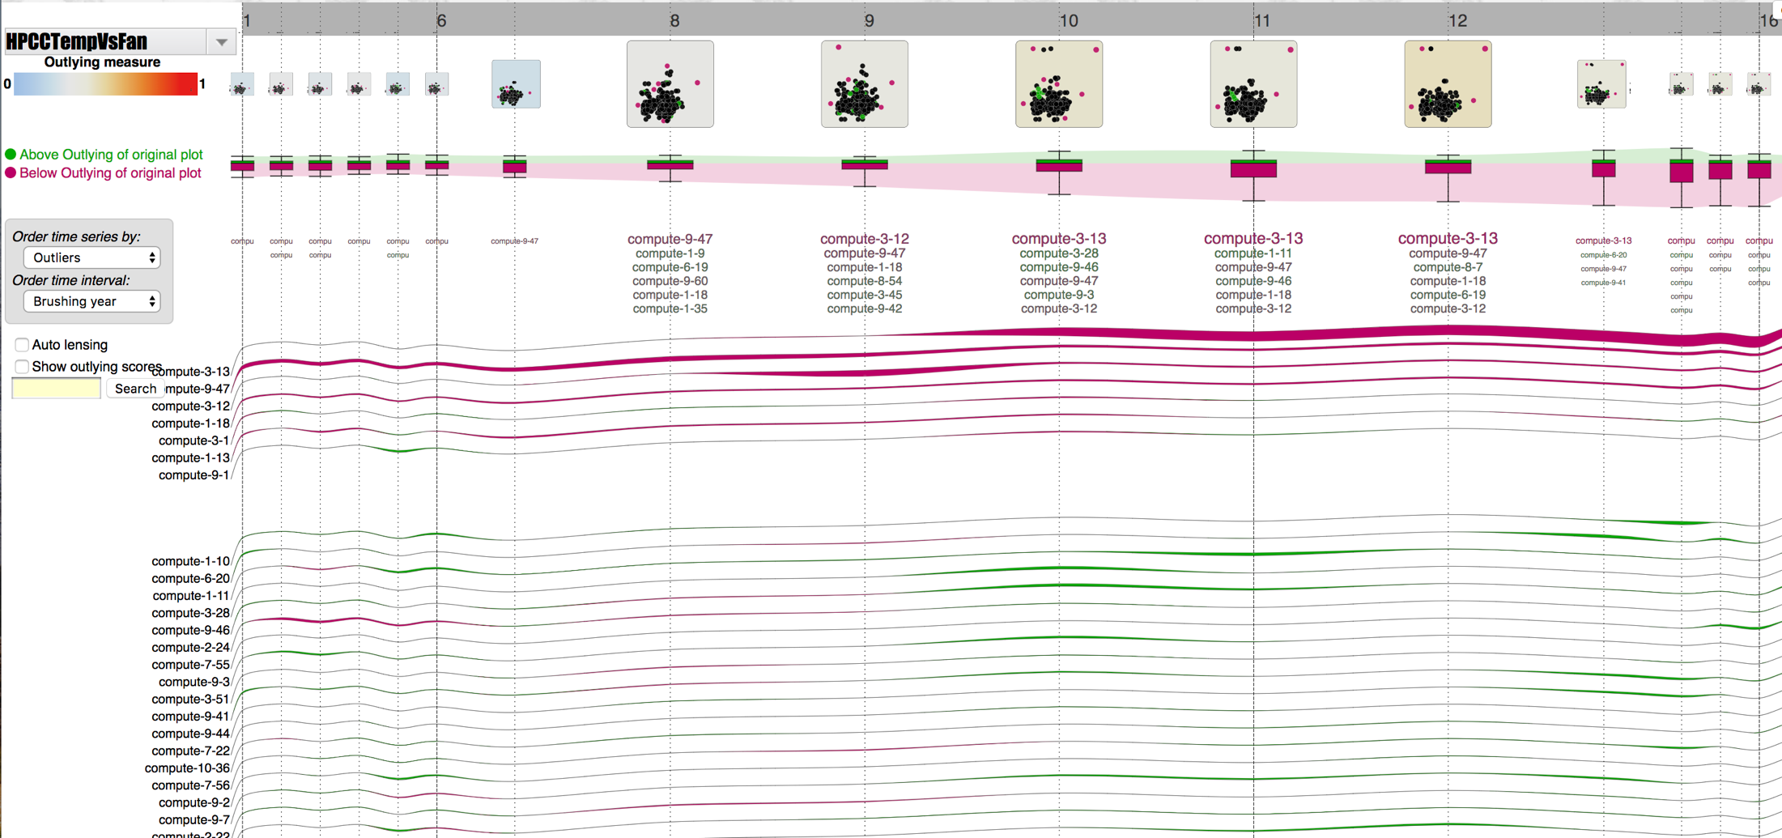
HPCC on Sep, 26 2018: CPU temperature vs Fan speed

Slide 17
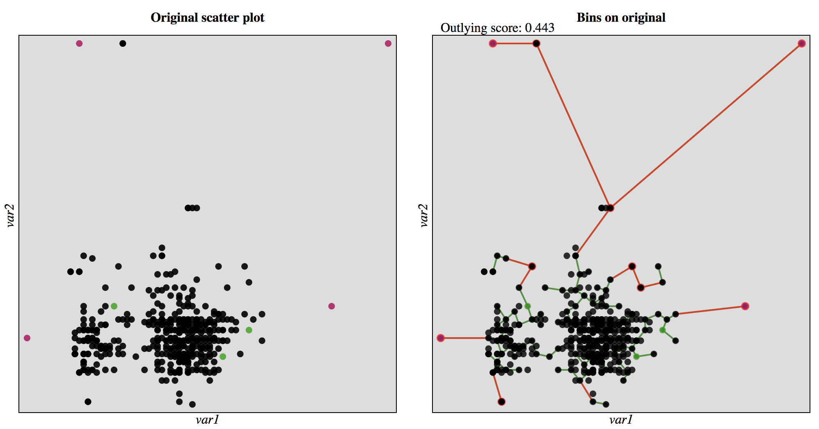
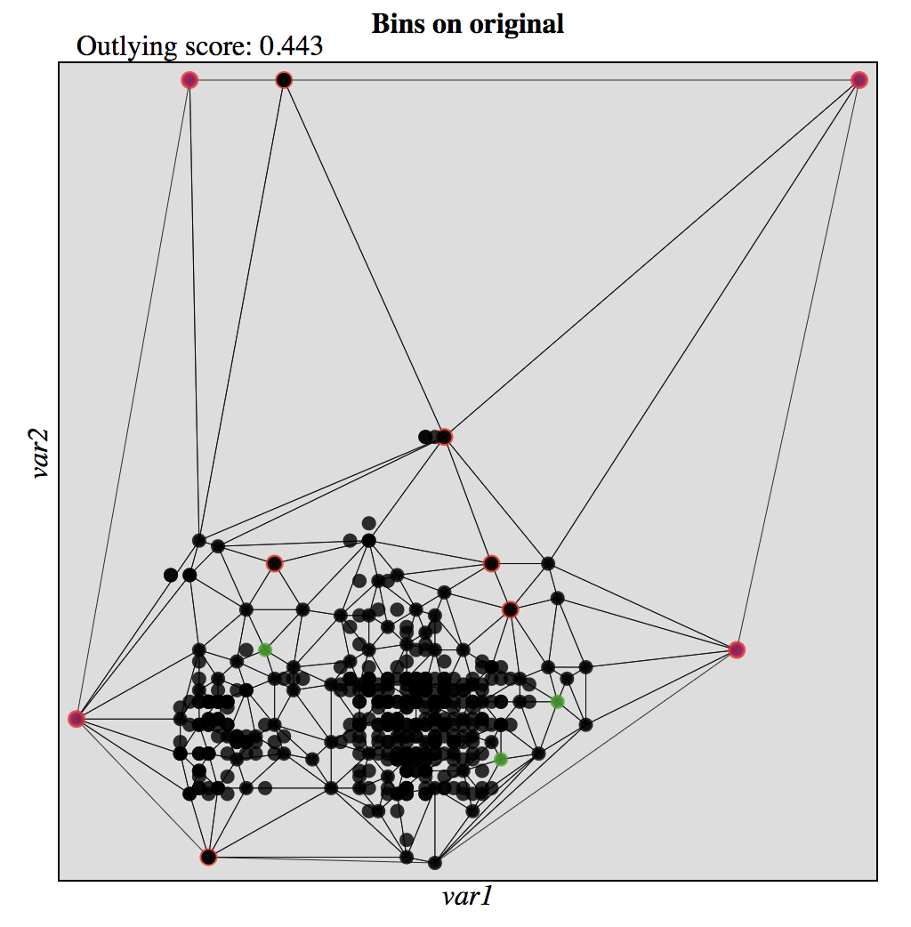
HPCC on Sep, 26 2018: CPU temperature vs Fan speed

Slide 18
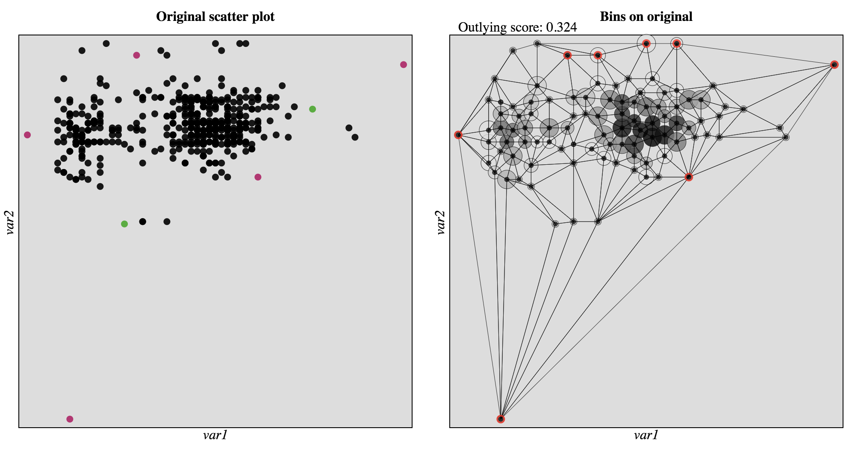
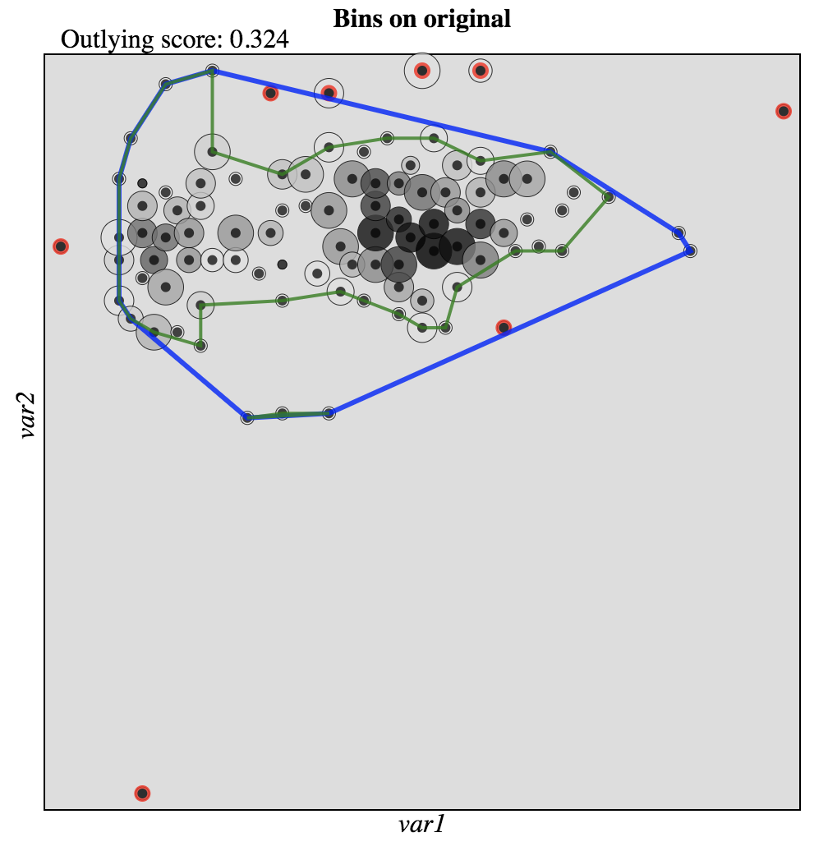
HPCC on Oct, 4 2018: CPU temperature vs Fan speed

Slide 19
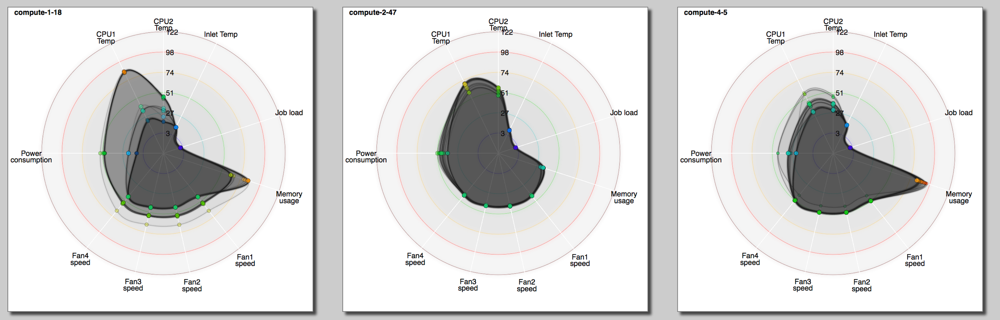
More than 2 dimensions?

Slide 20
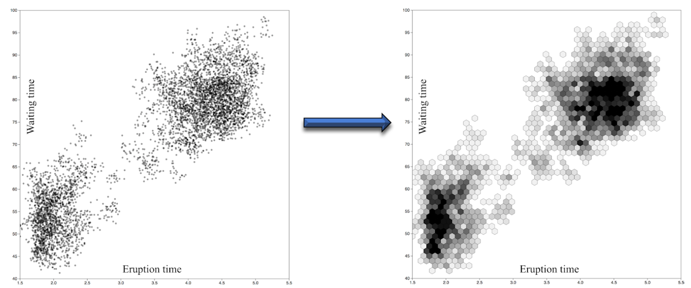
Too many data points?

Slide 21
Demos
HiperView:
https://idatavisualizationlab.github.io/HPCC/HiperView/demo.html
https://idatavisualizationlab.github.io/HPCC/HiperOverheatSep26/demo.html
Github repository:
https://github.com/iDataVisualizationLab/HPCC
Outlier detection:
https://outliagnostics.github.io/demos.html
Notes:
Will talk about each project individually
Dissemination: Drew’s poster is on risk simulation in colon/rectal cancer, which we will be investigating at the zip code level instead of county level
Aakriti’s paper on transdisciplinary teams, which has been presented at previous CAC meetings

Slide 22
Future Work

Slide 23
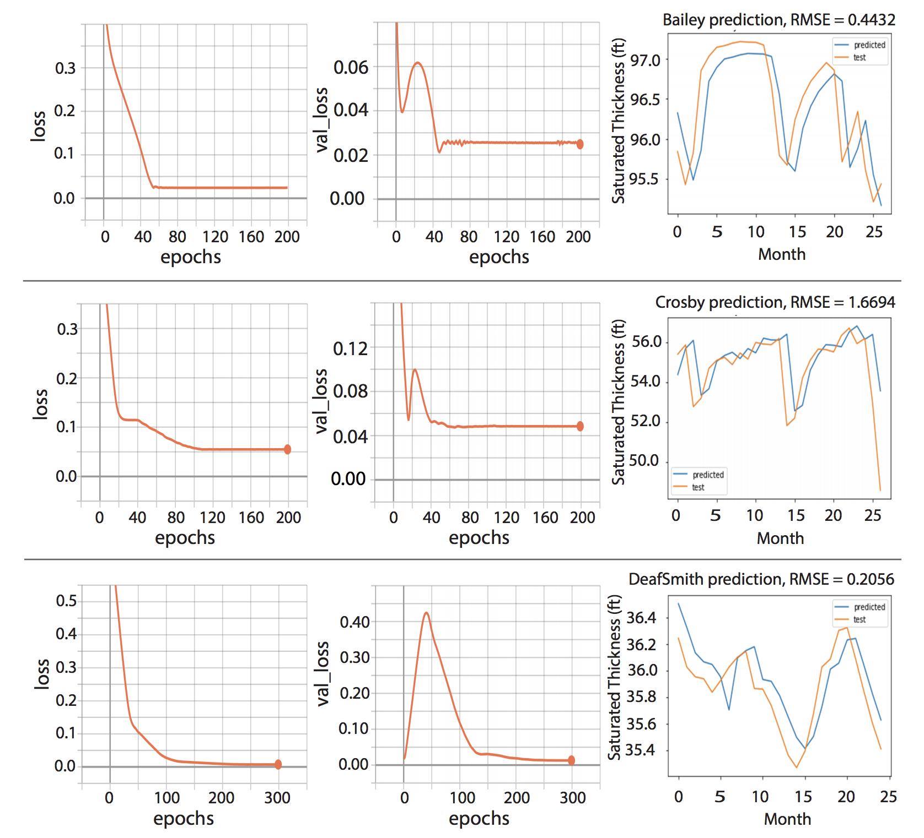
Predictive analytics
Vinh Nguyen, Fang Jin, and Tommy Dang
Predict Saturated Thickness using TensorBoard Visualization
The Visualization in Environmental Sciences

Slide 24
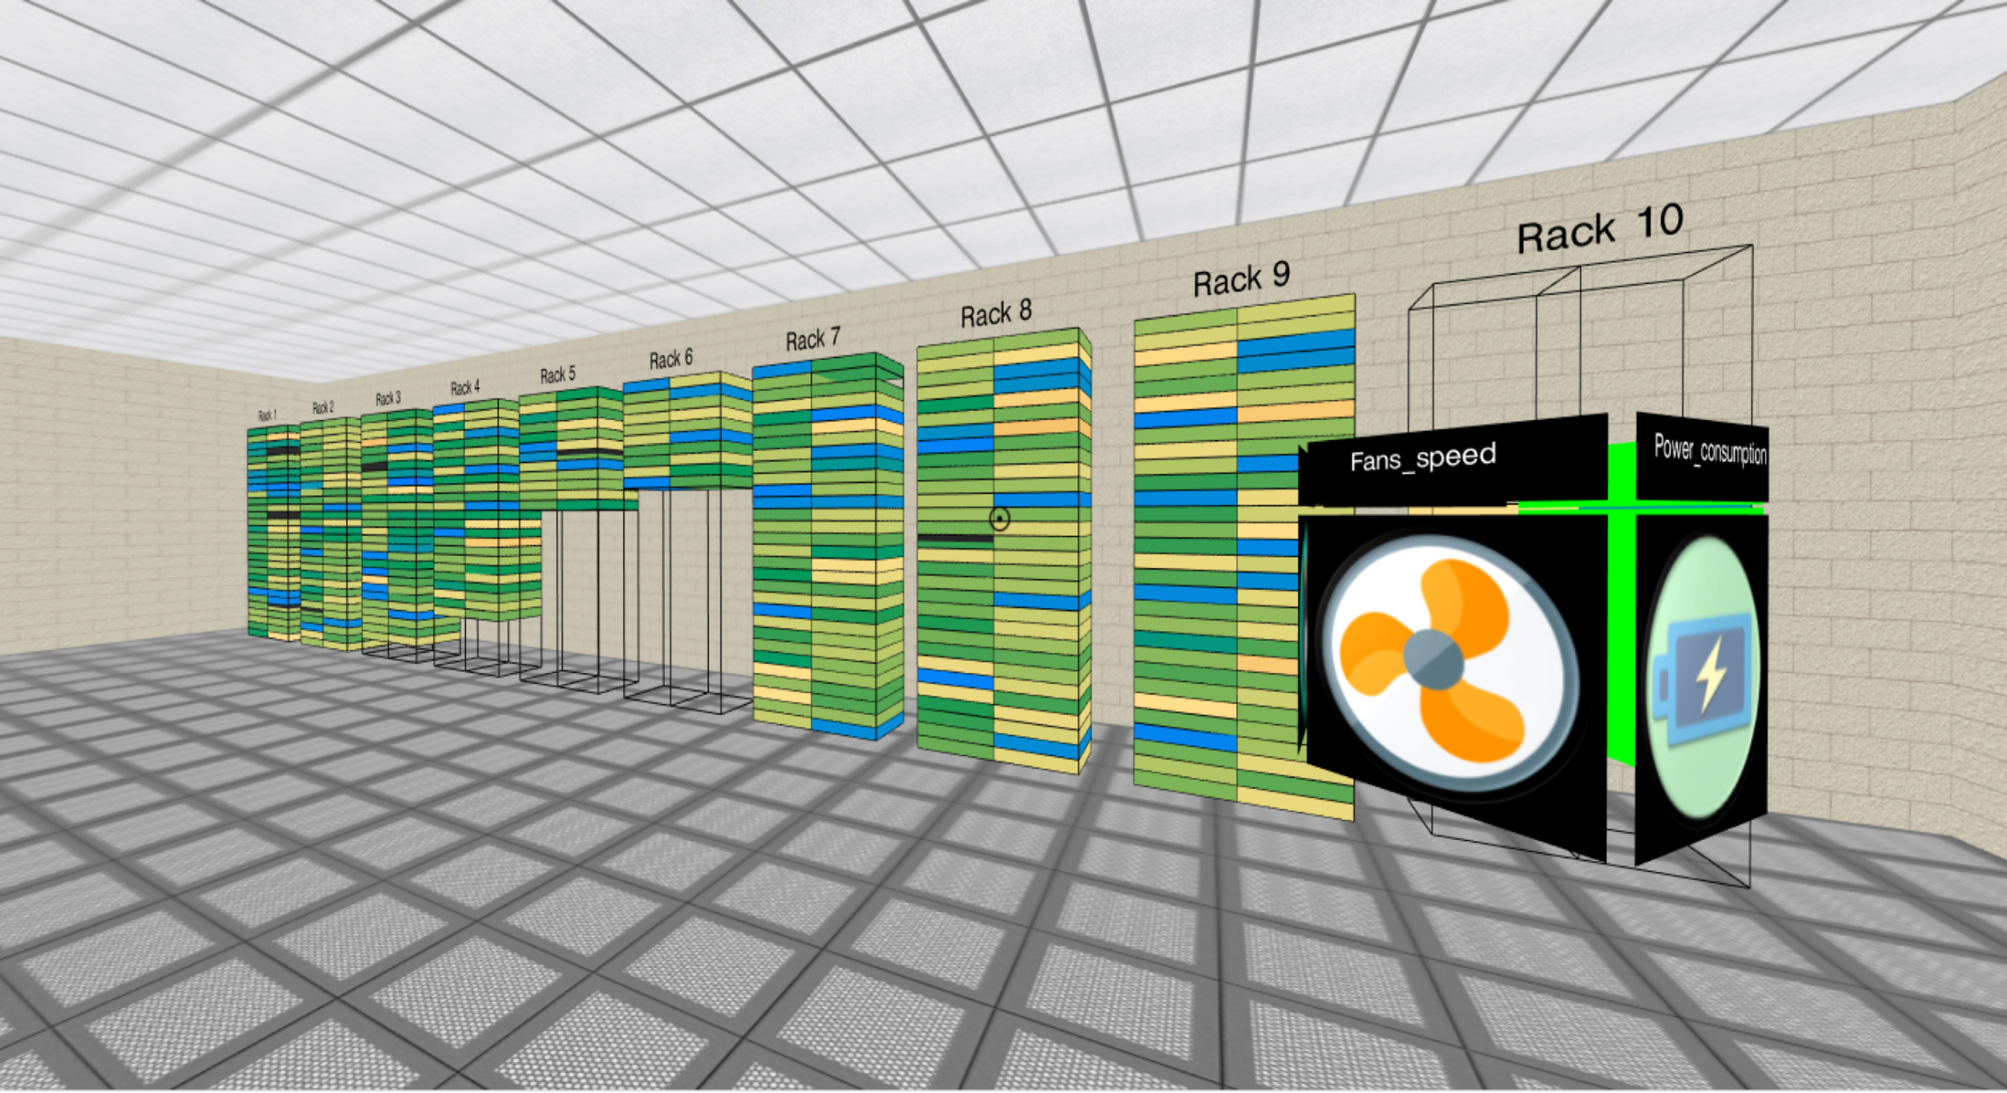

AR/VR

Slide 25
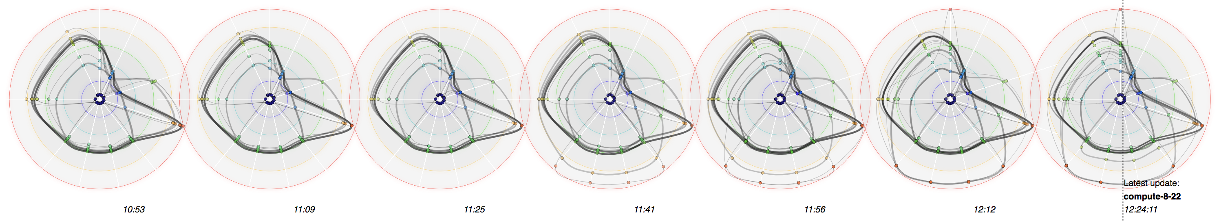
Questions?
Email: Tommy.Dang@ttu.edu

